Slide 1
File and I/O services
(System calls)
Rama Krishna.Katta

Slide 2
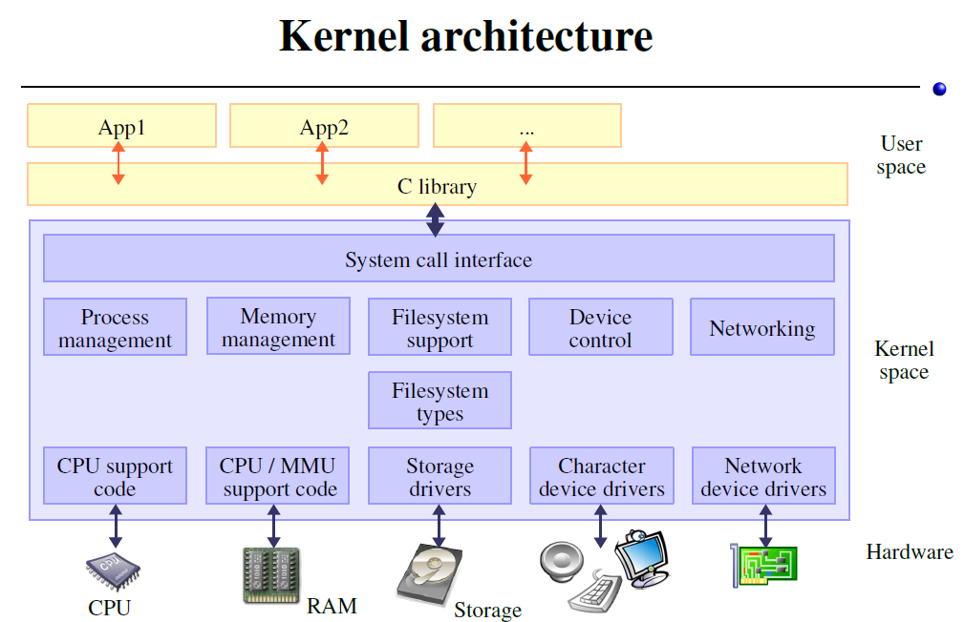
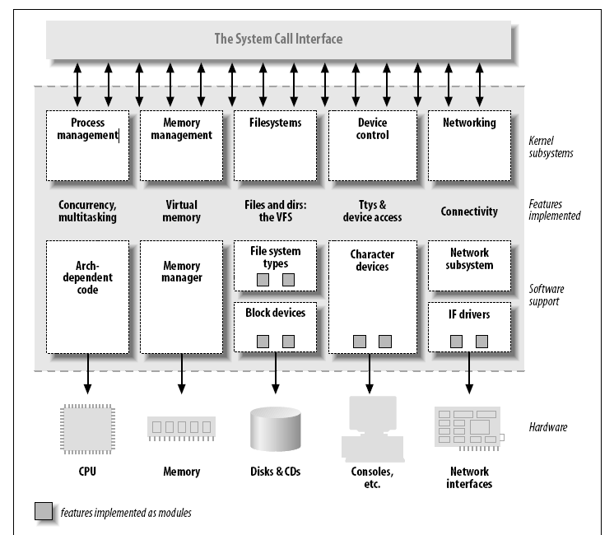
The following diagram shows the three important layers of a System.
• Applications
• Kernel
• Hardware
Applications
Kernel
Hardware
Linux Programming Essentials

Slide 3
A system call is implemented in the Linux kernel. When a program makes a system call, the arguments are packaged up and handed to the kernel, which takes over execution of the program until the call completes.
A system call isn’t an ordinary function call, and a special procedure is required to transfer control to the kernel. However, the C library (the implementation of the standard C library provided with Unix systems) wraps system calls with functions so that you can call them easily. Low-level I/O functions such as open and read are examples of system calls on Linux.
A system call is used by application (user) programs to request service from the operating system. The following statements illustrate why system calls are needed.
An operating system can access a system's hardware directly, but a user program is not given direct access to the hardware. This is done so that the kernel can keep the system safe and secure from malicious user programs.
But often, a user program requires some information from the hardware (e.g., from a web camera to show you the picture), but it cannot get the information directly. So, it requests the operating system to supply it the information. This request is made by using an appropriate system call.

Slide 4
A system call changes the processor state from user mode to kernel mode, so
that the CPU can access protected kernel memory.
The set of system calls is fixed. Each system call is identified by a unique number.
(This numbering scheme is not normally visible to programs, which identify system calls by name.) Each system call may have a set of arguments that specify information to be transferred from user space (i.e., the process’s virtual address space) to kernel space and vice versa.
System Call execution sequence:
1. The application program makes a system call by invoking a wrapper function
in the C library.
2. The wrapper function must make all of the system call arguments available to
the system call trap-handling routine. These arguments are passed to the wrapper via the stack, but the kernel expects them in specific reg-isters. The wrapper function copies the arguments to these registers.
3. Since all system calls enter the kernel in the same way, the kernel needs some
method of identifying the system call. To permit this, the wrapper function
copies the system call number into a specific CPU register ( %eax ).
4. The wrapper function executes a trap machine instruction ( int 0x80 ), which
causes the processor to switch from user mode to kernel mode and execute
code pointed to by location 0x80 (128 decimal) of the system’s trap vector.

Slide 5
5. In response to the trap to location 0x80 , the kernel invokes its system_call() routine (located in the assembler file arch/i386/entry.S ) to handle the trap. This handler:
a) Saves register values onto the kernel stack
b) Checks the validity of the system call number.
c) Invokes the appropriate system call service routine, which is found by using the system call number to index a table of all system call service routines (the kernel variable sys_call_table). Service routine performs required task. service routine returns a result status to the system_call() routine.
d) Restores register values from the kernel stack and places the system call
return value on the stack.
e)If the return value of the system call service routine indicated an error, the wrapper function sets the global variable errno.

Slide 6
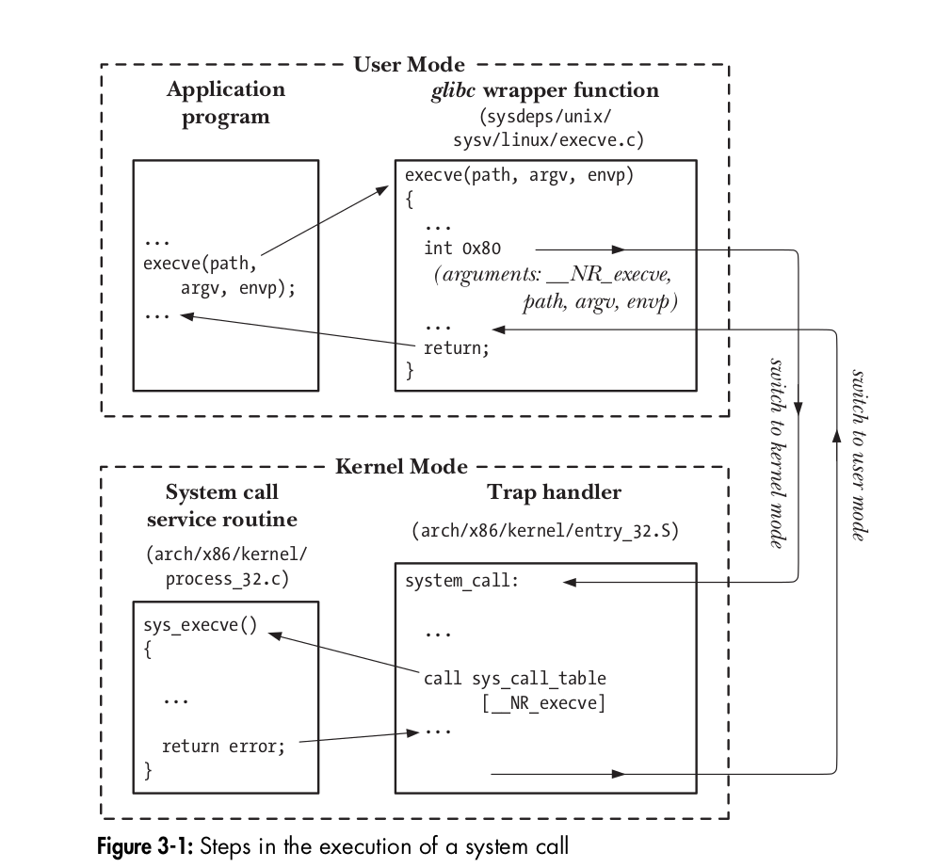
A system call executes in the kernel mode. Every system call has a number associated with it. This number is passed to the kernel and that's how the kernel knows which system call was made. When a user program issues a system call, it is actually calling a library routine. The library routine issues a trap to the Linux operating system by executing INT 0x80 (32 bit OS)assembly instruction. It also passes the system call number to the kernel using the EAX register. The arguments of the system call are also passed to the kernel using other registers (EBX, ECX, etc.). The kernel executes the system call and returns the result to the user program using a register. If the system call needs to supply the user program with large amounts of data, it will use another mechanism (e.g., copy_to_user call).

Slide 7
System call Execution sequence on 64-bit OS
1. Application Calls a Standard C Library Function
write(1, "hello", 5);
2. glibc Wrapper: libc.so
File (glibc source): sysdeps/unix/sysv/linux/x86_64/write.S . This is an assembly file that wraps the actual syscall. It loads syscall number and arguments into registers, and issues the syscall instruction. /usr/include/x86_64-linux-gnu/asm/unistd_64.h
mov rax, __NR_write ; syscall number (1)
mov rdi, arg1 ; file descriptor
mov rsi, arg2 ; pointer to buffer
mov rdx, arg3 ; number of bytes
syscall ; enter kernel
3. CPU executes syscall instruction : CPU switches from user mode (Ring 3) to kernel mode (Ring 0).
4. Kernel Entry: entry_SYSCALL_64
File: arch/x86/entry/entry_64.S This assembly file: , Saves registers, Sets up kernel stack, Transfers control to C code: do_syscall_64()
5. Handler: do_syscall_64()
File: arch/x86/entry/common.c This: Reads syscall number from regs->ax Dispatches to sys_call_table[rax]
6. System Call Table Lookup File: arch/x86/entry/syscalls/syscall_64.tbl
This tells the kernel to use sys_write() for syscall 1.
7. Actual System Call Implementation File: fs/read_write.c

Slide 8
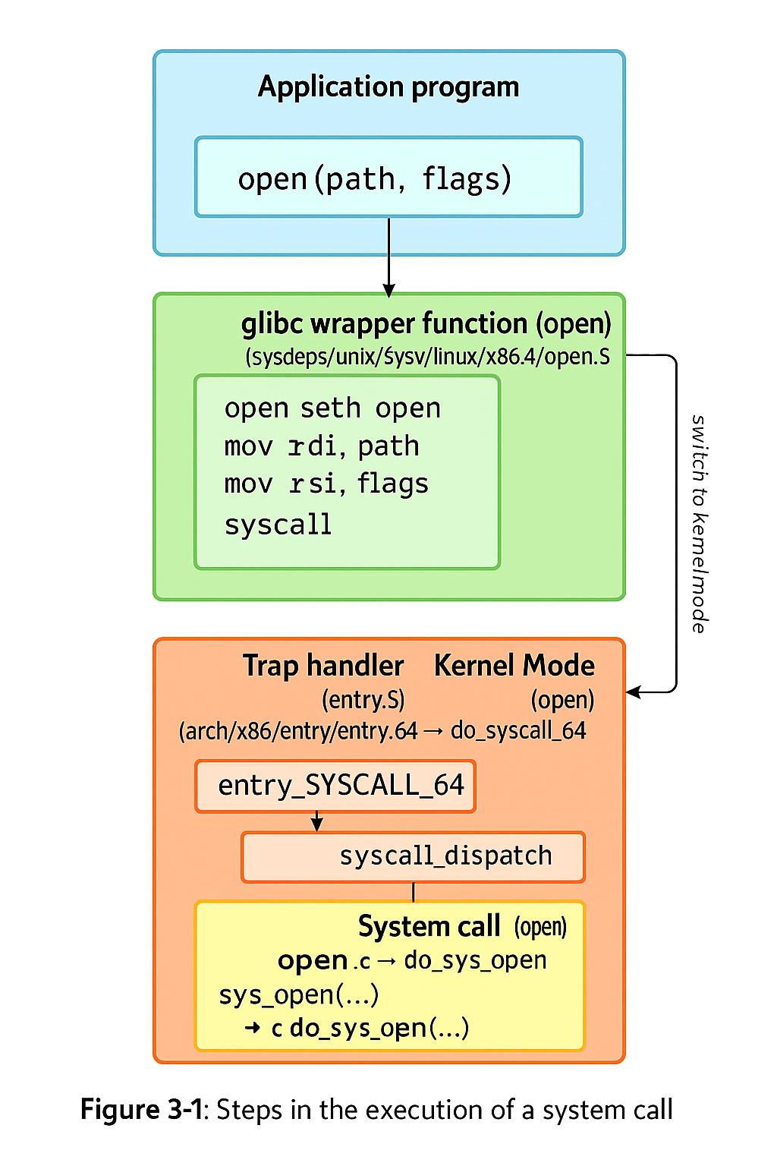

Slide 9
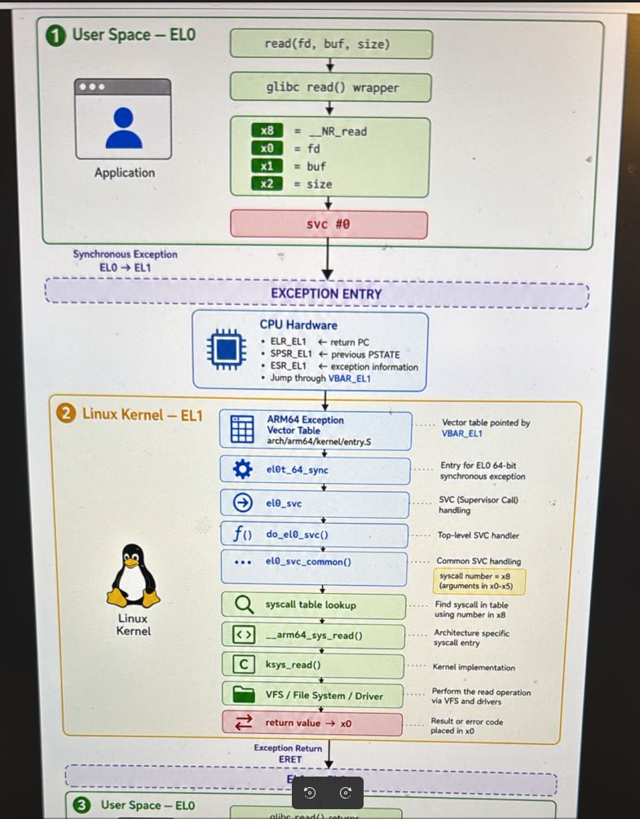

Slide 10
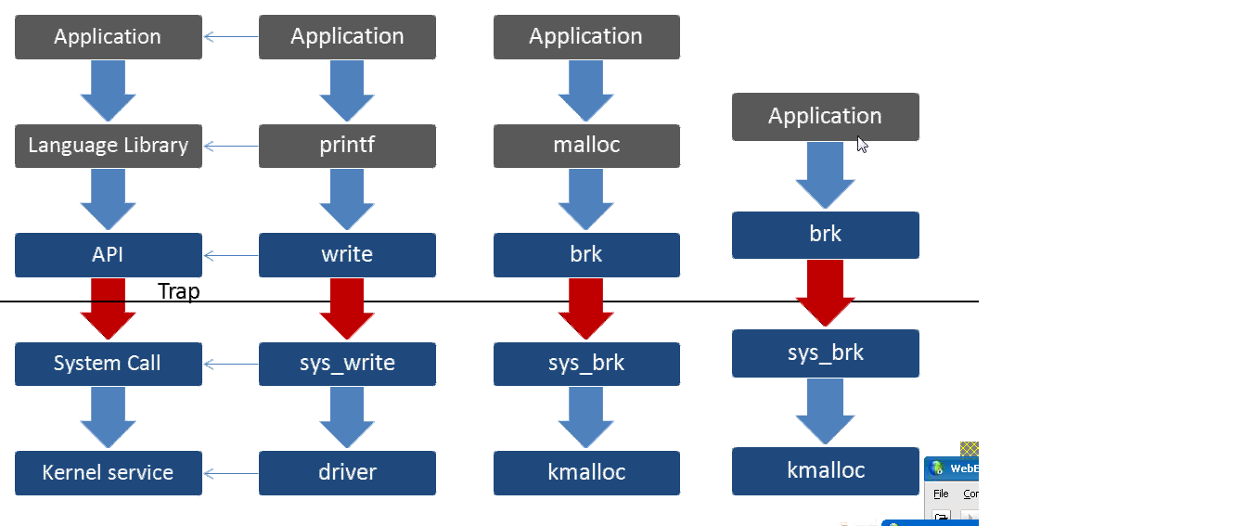

Slide 11
System calls & ‘C’ library
A library function is an ordinary function that resides in a library external to your program.
For example, getopt_long and fopen are functions provided in the C library. A call to a
library function is just like any other function call. The arguments are placed in processor
Registers or onto the stack, and execution is transferred to the start of the function’s code, which
typically resides in a loaded shared library.
Many library functions don’t make any use of system calls (e.g., the string-
manipulation functions). On the other hand, some library functions are layered on
top of system calls.
For example, the fopen() library function uses the open() system call to actually open a file.
Often, library functions are designed to provide a more caller-friendly interface than the
underlying system call.
For example, the printf() function provides output formatting and data buffering,
whereas the write() systemcall just outputs a block of bytes.
Similarly, the malloc() and free() functions performvarious bookkeeping tasks
that make them a much easier way to allocate and free memory than the
underlying brk() system call.

Slide 12
Handling Errors from System Calls and Library Functions
Almost every system call and library function returns some type of status value indi
cating whether the call succeeded or failed. This status value should always be
checked to see whether the call succeeded. If it did not, then appropriate action
should be taken—at the very least, the program should display an error message
warning that something unexpected occurred.
#include <stdio.h>
void perror(const char *msg );
fd = open(pathname, flags, mode);
if (fd == -1) {
perror("open");
exit(EXIT_FAILURE);
}
The perror() function prints the string pointed to by its msg argument, followed
by a message corresponding to the current value of errno.

Slide 13
Linux provides uniform interface to various kinds of objects through its basic I/O system calls. All these objects are called files. But these files could refer to different things like, regular file, character device, block device, named pipe (FIFO), symbolic link, or a network socket. This means that the same four system calls—open(), read(), write(), and close()—are used to perform I/O on all types of files, including devices such as terminals
So we can use read() and write() system calls to:
Read and write to files on hard disk or floppy disk
Read and write to I/O devices like printers, modems, terminals, Audio devices
Read and write to IPC object such as Pipes and FIFOs
Read and write to network objects such as Sockets
open(),read(),write(),lseek(),fcntl(),ioctl(),close() dup() dup2() unlink()
$./copy test test.old Copy a regular file
$./copy a.txt /dev/tty Copy a regular file to this terminal
$./copy /dev/tty b.txt Copy input from this terminal to a regular file
$./copy /dev/pts/16 /dev/tty Copy input from another terminal
Programs on open, read, write, lseek and stat Execute Program
About fd redirection, Dup System call Execute Program

Slide 14
Exercise:
1. struct winsize w; Use this structure
2. Open /dev/tty with open system call
3. Get terminal attributes using ioctl(fd, TIOCGWINSZ, &w)
4. Print current terminal size, columns, xpixel, ypixel.
5. Set terminal size to 40x100 using ioctl(fd, TIOCSWINSZ, &w)

Slide 15
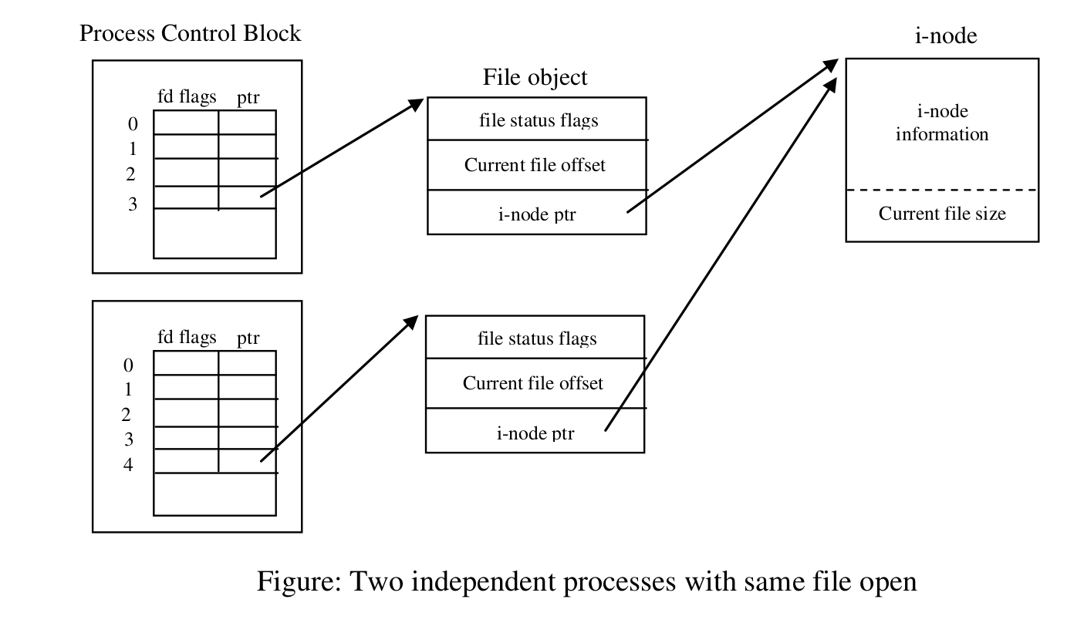

Slide 16
File I/O at a Specified Offset: pread() and pwrite()
The pread() and pwrite() system calls operate just like read() and write(), except that the file I/O is performed at the location specified by offset, rather than at the current file offset. The file offset is left unchanged by these calls.
Calling pread() is equivalent to atomically performing the following calls:
off_t orig;
orig = lseek(fd, 0, SEEK_CUR);
lseek(fd, offset, SEEK_SET); /* Save current offset */
s = read(fd, buf, len);
lseek(fd, orig, SEEK_SET); /* Restore original file offset */
These system calls can be particularly useful in multithreaded applications. This means that the file offset for each open file is global to all threads. Using
pread() or pwrite(), multiple threads can simultaneously perform I/O on the same
file descriptor without being affected by changes made to the file offset by other
threads. If we attempted to use lseek() plus read() (or write()) instead, then we would create a race condition
-> Execute programs on pread, pwrite

Slide 17
Vector I/O
The readv() and writev() system calls perform scatter-gather I/O.
#include <sys/uio.h>
ssize_t readv(int fd , const struct iovec * iov , int iovcnt );
Returns number of bytes read, 0 on EOF, or –1 on error
ssize_t writev(int fd , const struct iovec * iov , int iovcnt );
Returns number of bytes written, or –1 on error
Instead of accepting a single buffer of data to be read or written, these functions transfer multiple buffers of data in a single system call. The set of buffers to be
transferred is defined by the array iov. The integer iovcnt specifies the number of elements in iov. Each element of iov is a structure of the following form:
struct iovec {
void *iov_base; /* Start address of buffer */
size_t iov_len; /* Number of bytes to transfer to/from buffer */
};
-> Execute program on sg_iovector

